Slide 1
Unit testing using React Testing Library

Slide 2
Agenda
Overview of unit testing
React testing library overview.
Anatomy and best practices for writing unit tests.
Selecting elements, Interactions, and Assertions.
Mocking
Async tests
Coverage
Coding exercise

Slide 3
Unit testing overview
1

Slide 4
End to End Testing
Integration Testing Shallow - Deep
Black Box
White Box
Unit Testing

Slide 5
Make refactoring easier
Reliability
Benefits
Documentation
Early bug detection
Notes:
Reliability: Unit tests act as a safety net during software updates or changes, ensuring that existing features continue to work as intended. ensuring that changes to the codebase don't inadvertently introduce new problems or break existing functionality.
Early Bug Detection: Unit testing helps catch bugs and errors in the early stages of development, making it easier and less expensive to fix issues.
Code Documentation: Unit tests serve as a form of documentation, showcasing how individual units of code are intended to function. This can be helpful for developers working on the project.
Easy Refactoring: With unit tests in place, developers can refactor code confidently, knowing that the tests will catch issues if something goes wrong during the process.

Slide 6
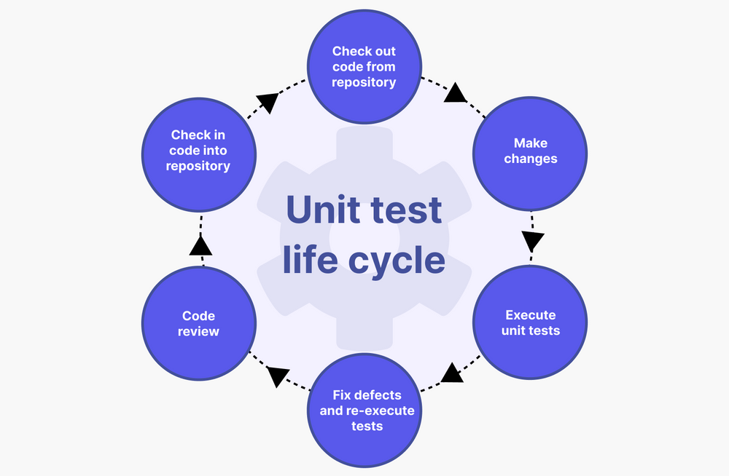

Slide 7
React testing library overview
2

Slide 8
React testing library
Focus on testing the functionality of the component rather than the implementation details.
Avoids False negatives: test fails because test is broken, not the code.
Avoids False positives: test succeeds but it should fail.
Easier to refactor (changes to implementation but not functionality) without breaking tests.

Slide 9
Avoid testing the implementation details:
Internal state of a component
Internal methods of a component
Lifecycle methods of a component
Child components

Slide 10
Anatomy and best practices for writing unit tests.
3

Slide 11
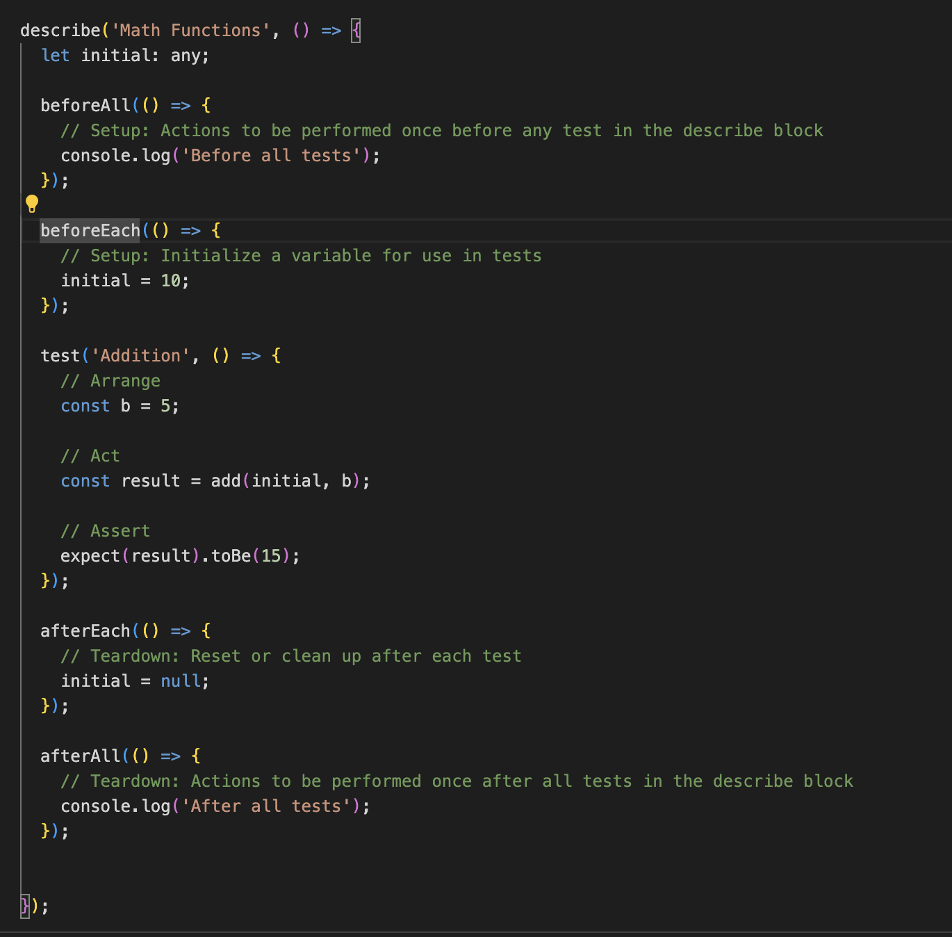
Test Anatomy and best practices
Describe and it/test functions
Setup and teardown
AAA:
Arrange: Set up the preconditions and inputs for the test. Mocks, spy, test data…etc
Act: Perform the action or operation that you are testing.
Assert: Verify that the actual results match the expected results.
Naming convention:
Test file name should be the same as component.
Test title should be descriptive of what test does -> ‘state under test’ and ‘expected behavior’.
Keep the test file as close to the component as possible to make the relative imports easier and more readable.

Slide 12
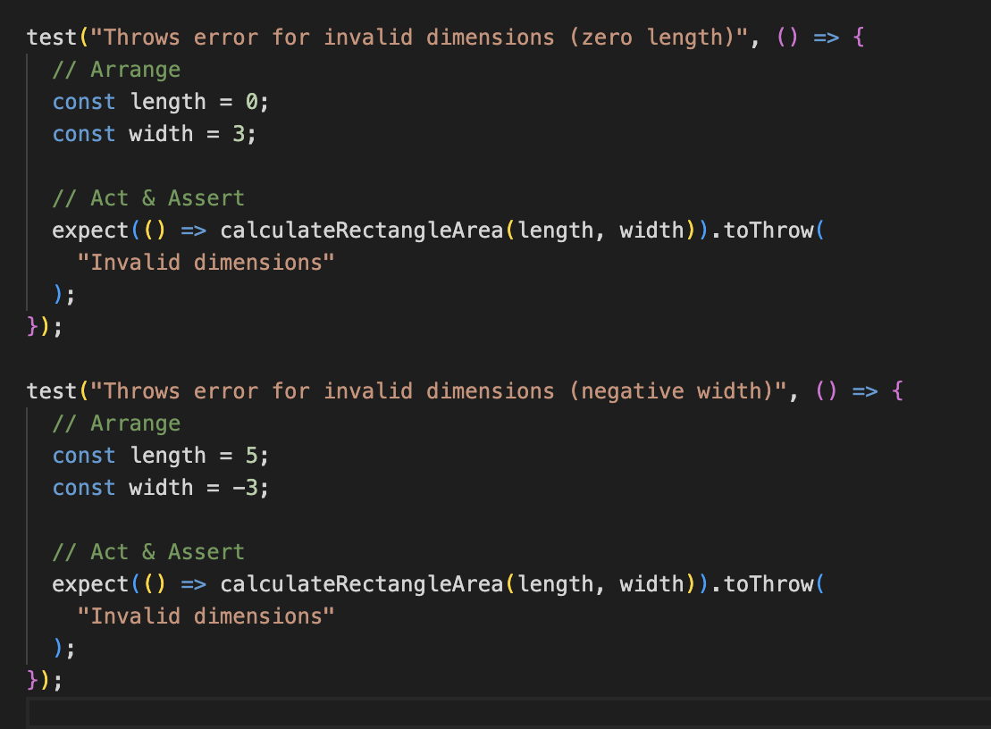
Each test should focus on a single concept or behavior.

Slide 13
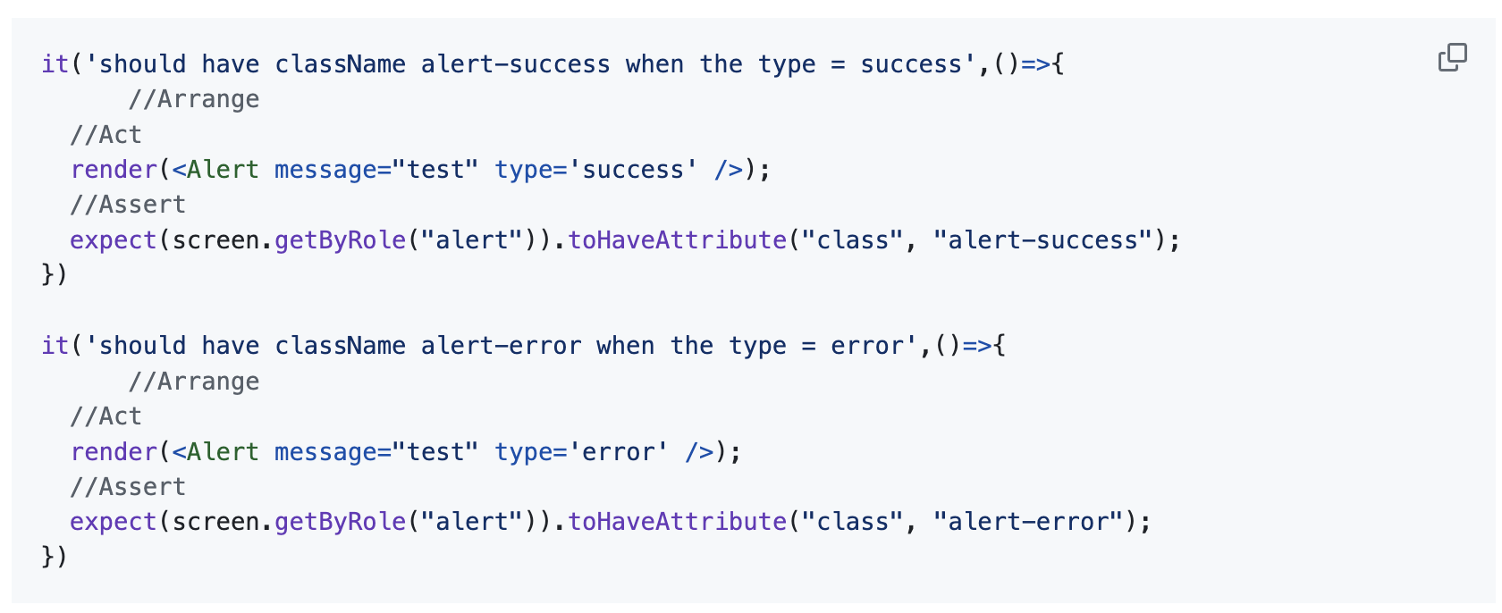
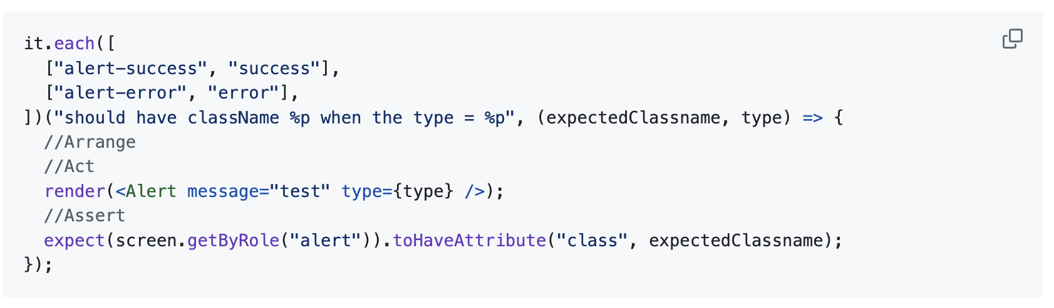
Avoid repeating test logic

Slide 14
Selecting elements, Interactions, and Assertions.
4

Slide 15
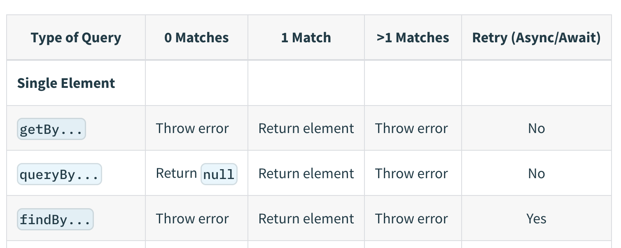
Type of queries
Queries reference
Keep in mind to prioritize using queries that reflect user experience

Slide 16
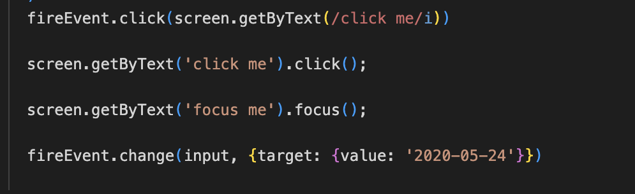
Interactions

Slide 17
Assertions
In addition to jest assertions RTL has extended more assertions that can be imported in jest’s config by importing it in setupTests.ts
import '@testing-library/jest-dom’;
Some of the added assertions:
expect(element).toBeInTheDocument();
expect(element).toHaveTextContent('Hello’);
expect(element).toHaveAttribute('id', 'myId’);
expect(element).toBeVisible();
expect(inputElement).toBeDisabled();
…etc

Slide 18
Mocking
4

Slide 19
A unit needs to be isolated from all dependencies
API requests
Interaction with other components
Unit under test
Interaction with Hooks
Interaction with other logic (external functions…etc)

Slide 20
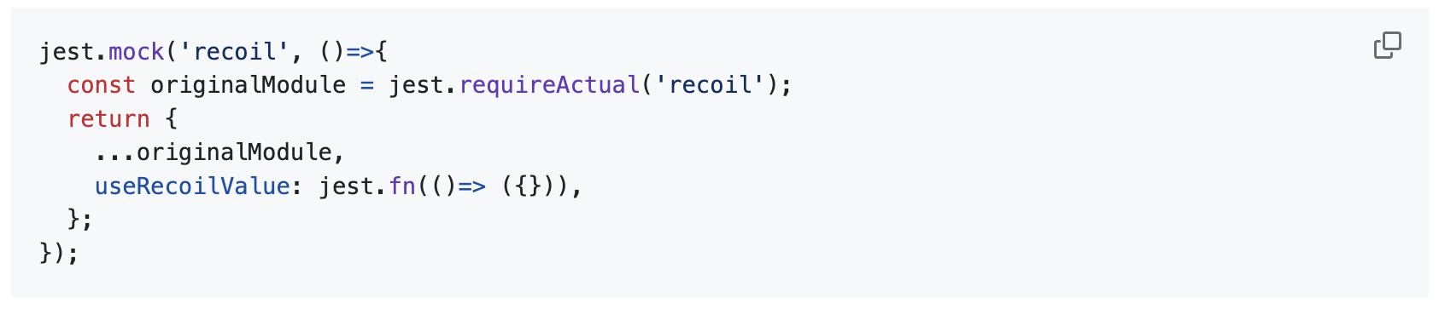
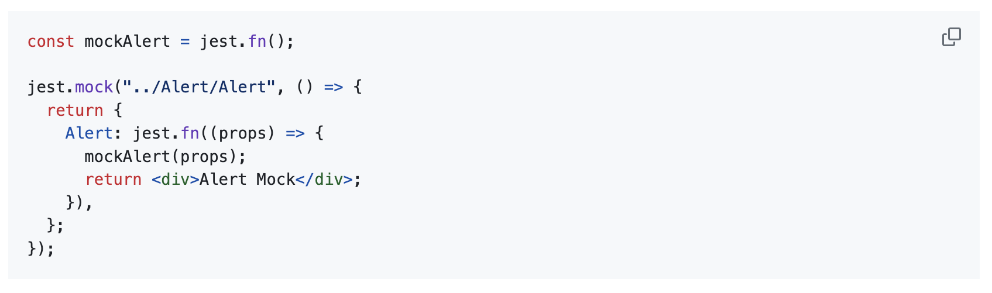
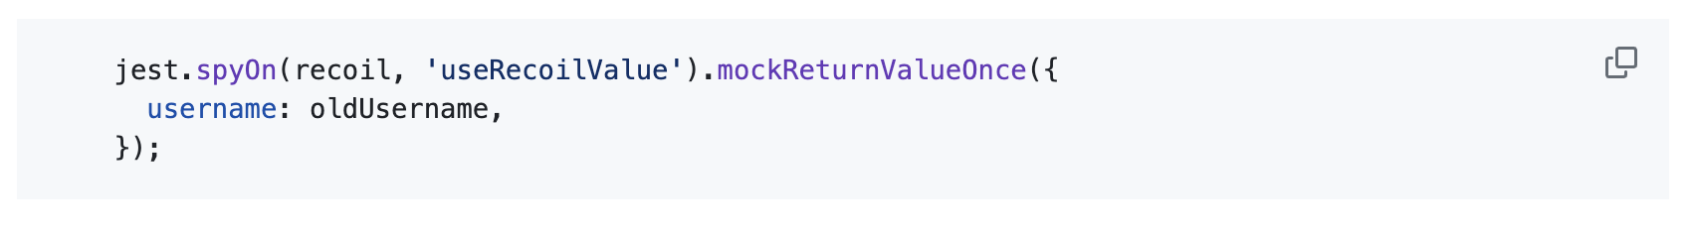
Mocking
The Simplest method is to create __mocks___ folder next to the module we want to mock.
Jest’s mock function: Note: the 'jest.mock' method must be called outside of any tests, it will be executed before running any test
The spyOn method
mockReturnValueOnce
mockResolvedValue
mockRejectedValue
mockImplementation

Slide 21
Async Tests
5

Slide 22
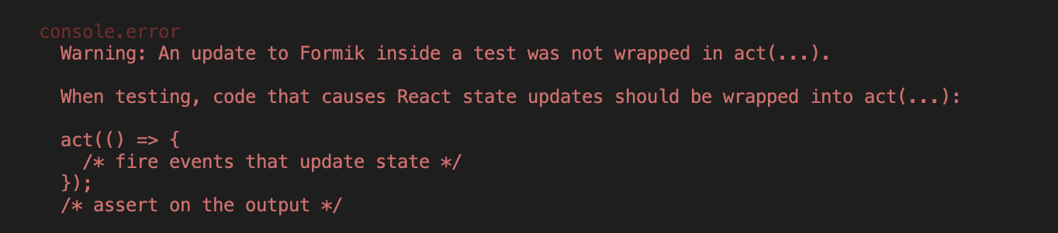
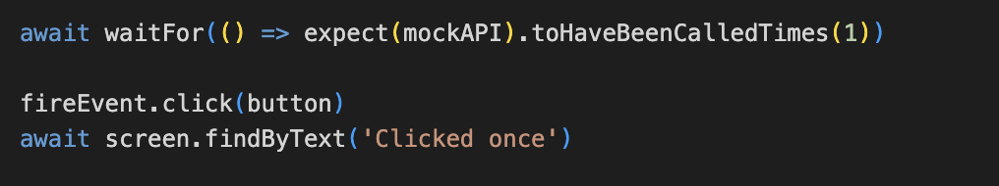
When to use async methods
Async Functions:
waitFor: Wait until the callback does not throw an error.
findBy queries: combination of getBy and waitFor
waitForElementToBeRemoved
When we want to test an element appearing or changing after an API request, a promise resolving, event, user action, or a timeout.
When you get a very famous warning ‘test was not wrapped in act'

Slide 23
Coding time
6

Slide 24
Coverage
7

Slide 25
Code coverage
So after we start writing tests, we want to be able to measure how good our tests are.
Coverage report gives us metrics about the code that was executed, while running our tests:
how many lines of code
how many branches ( if conditions, switch cases, loops ...etc) did we cover
how many functions

Slide 26
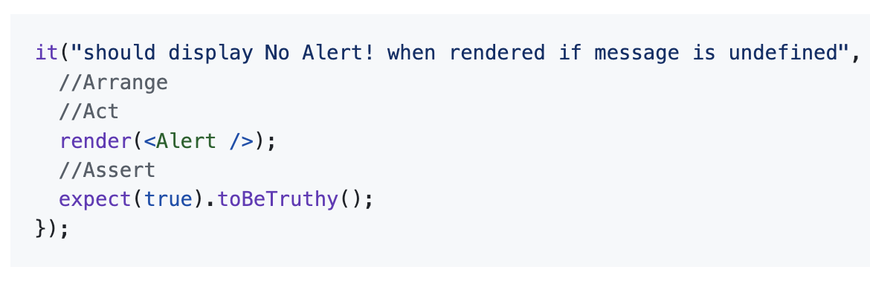
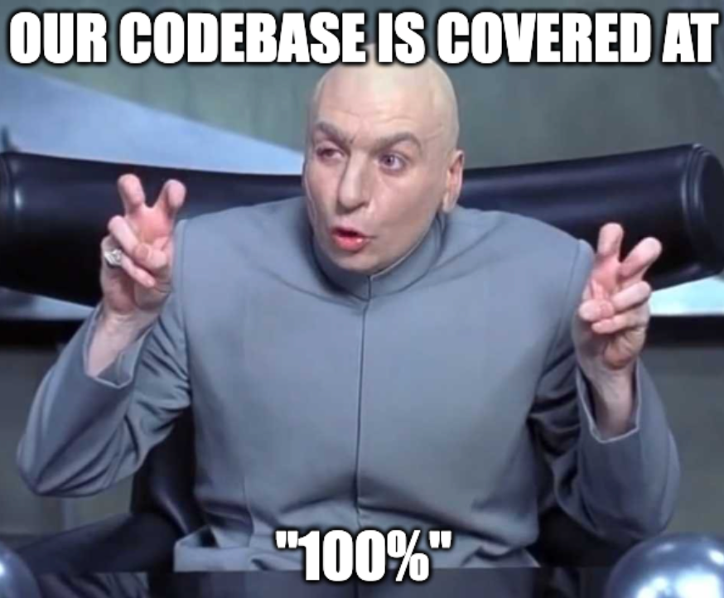
100% isn’t always correct
it is important to rely on coverage but it doesn't eliminate the need for code review and writing good tests.

Slide 27
Questions?

Slide 28
Additional material
https://github.vodafone.com/VFGroup-Reuse-Assets/Unit-Testing-using-Jest-and-React-Testing-Library

Slide 29
Thank you

